Slide 1
Stacks and Queues

Slide 2
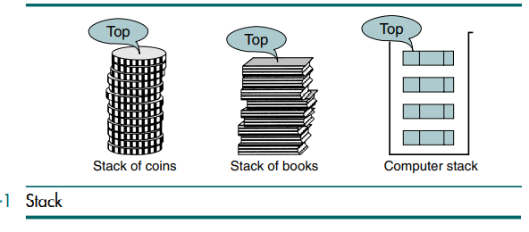
Fundamentals of stack
A stack is a linear list in which all additions and deletions are restricted to one end, called the top. If you insert a data into a stack and then remove it , the order of the data is reversed. Data input as {5, 10, 15, 20} is removed as{20, 15, 10, 5}. This reversing attribute is why stacks are known as the last in–first out (LIFO)data structure.
Any situation in which you can only add or remove an object at the top is a stack. If you want to remove any object other than the one at the top, you must first remove all objects above it.
A graphic representation of a stack is shown in Figure.
These are two basic operations associated with stack:
Push is the term used to insert/add an element into a stack.
Pop is the term used to delete/remove an element from a stack.

Slide 3
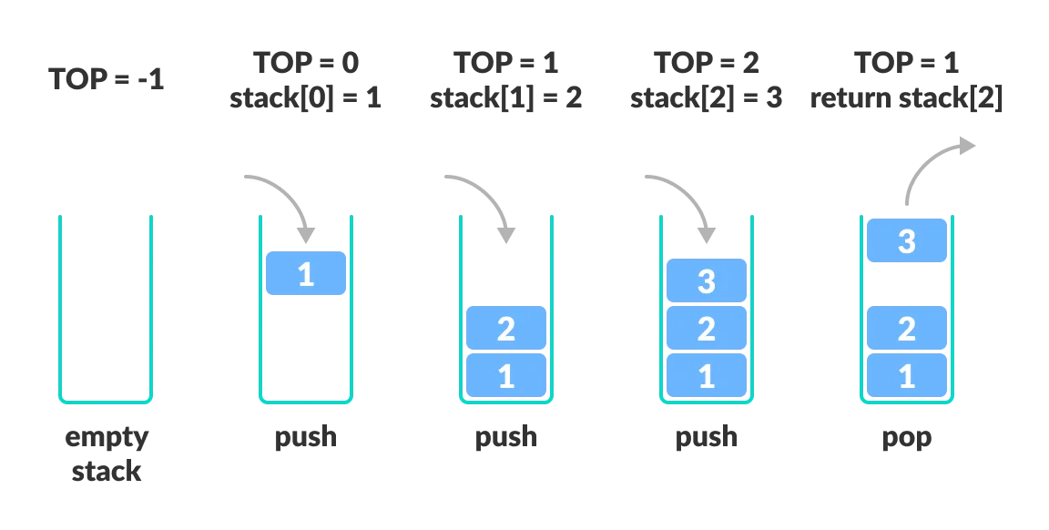
Array representation of stack:
Stack will be maintained by a linear array stack, a pointer variable TOP which contains the location of top element of stack, and a variable MAXSTK which gives maximum number of elements that can be held by the stack.

Slide 4
Procedure: PUSH(STACK, TOP, MAXSTK, ITEM)
This procedure pushes an ITEM onto the stack.
1. [Stack already filled?]
If TOP=MAXSTK, then: Print: OVERFLOW, and Return.
2. Set TOP:= TOP +1 [increases top by 1]
3. Set STACK[TOP] :=ITEM [Inserts ITEM in new TOP position]
4. Return
Procedure: POP(STACK, TOP, ITEM)
This procedure deletes the top element of stack and assigns it to the variable ITEM.
1. [Stack has an item to be removed?]
If TOP = 0, then: Print: UNDERFLOW, and Return.
2. Set ITEM := STACK[TOP]. [Assigns TOP element to ITEM.]
3. Set TOP := TOP – 1. [Decreases TOP by 1.]
4. Return

Slide 5
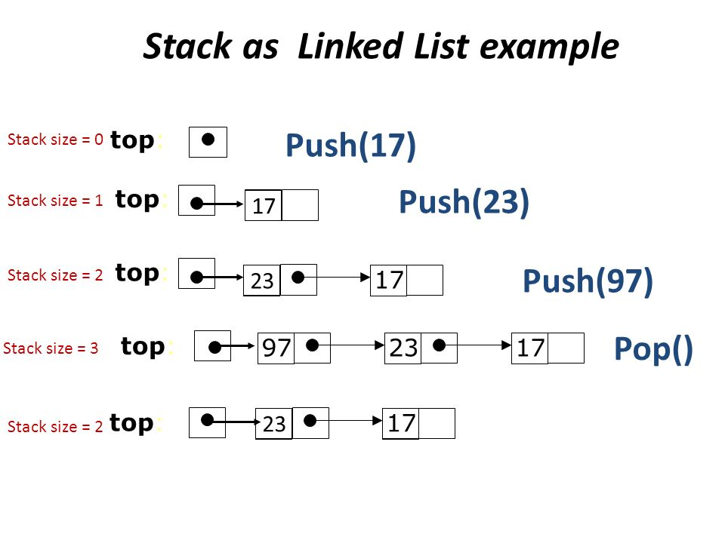

Slide 6
PUSH_LINKSTACK(INFO,LINK,TOP, AVAIL,ITEM)
This procedure pushes an ITEM into a linked stack
1. [Available space?]
If AVAIL= NULL, then Write OVERFLOW and Exit.
2. [Remove first node from AVAIL list]
Set NEW := AVAIL and AVAIL := LINK[AVAIL].
3. Set INFO[NEW] := ITEM [Copies ITEM into new node}
4. Set LINK[NEW] := TOP [New node points to the original top node in the stack]
5. Set TOP = NEW [Reset TOP to point to the new node at the top of the stack]
6. Exit

Slide 7
POP_LINKSTACK(INFO,LINK,TOP, AVAIL,ITEM)
This procedure deletes the top element of a linked stack and assigns it to the variable ITEM
1. [Stack has an item to be removed?]
If TOP = NULL, then Write UNDERFLOW and Exit.
2. Set ITEM := INFO[TOP] [Copies the top element of stack into ITEM]
3. Set TEMP :=TOP and TOP =LINK[TOP]
[Remember the old value of the TOP pointer in TEMP and reset TOP to point to the next element in the stack]
4. [Return deleted node to the AVAIL list]
Set LINK[TEMP] = AVAIL and AVAIL = TEMP
5. Exit

Slide 8
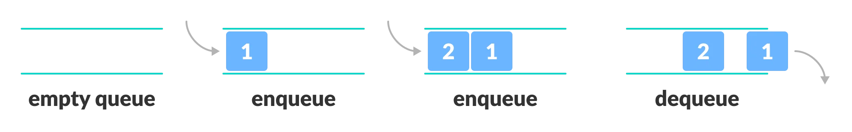
Fundamentals of Queues
A Queue is a linear list of elements in which deletions can take place only at one end, called the front, and insertions can take place only at the other end, called the rear.
Queues are also called first-in first-out (FIFO) lists, since the first element in a queue will be the first element out of the queue.
e.g. the people waiting in line at a bank form queue, where the person in line is the first person to be waited on; and so on.
An example of queue in computer science occurs in timesharing system, in which programs with the same priority form a queue while waiting to be executed.

Slide 9
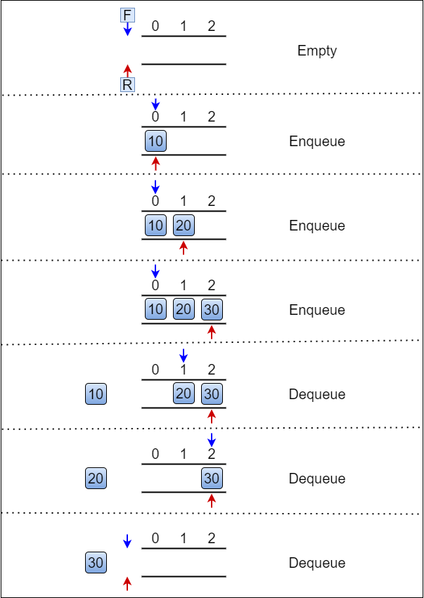

Slide 10
Algorithm: Insertion in Queue
Step 1: IF REAR = MAX - 1
Write OVERFLOW
Go to step 4
[END OF IF]
Step 2: IF FRONT = -1 and REAR = -1
SET FRONT = REAR = 0
ELSE
SET REAR = REAR + 1
[END OF IF]
Step 3: Set QUEUE[REAR] = NUM
Step 4: EXIT

Slide 11
Algorithm: Deletion in Queue
Step 1: IF FRONT = -1 or FRONT > REAR
Write UNDERFLOW
ELSE
SET VAL = QUEUE[FRONT]
IF FRONT = REAR
SET FRONT = REAR =-1
ELSE
SET FRONT = FRONT + 1
[END OF IF]
[END OF IF]
Step 2: EXIT

Slide 12
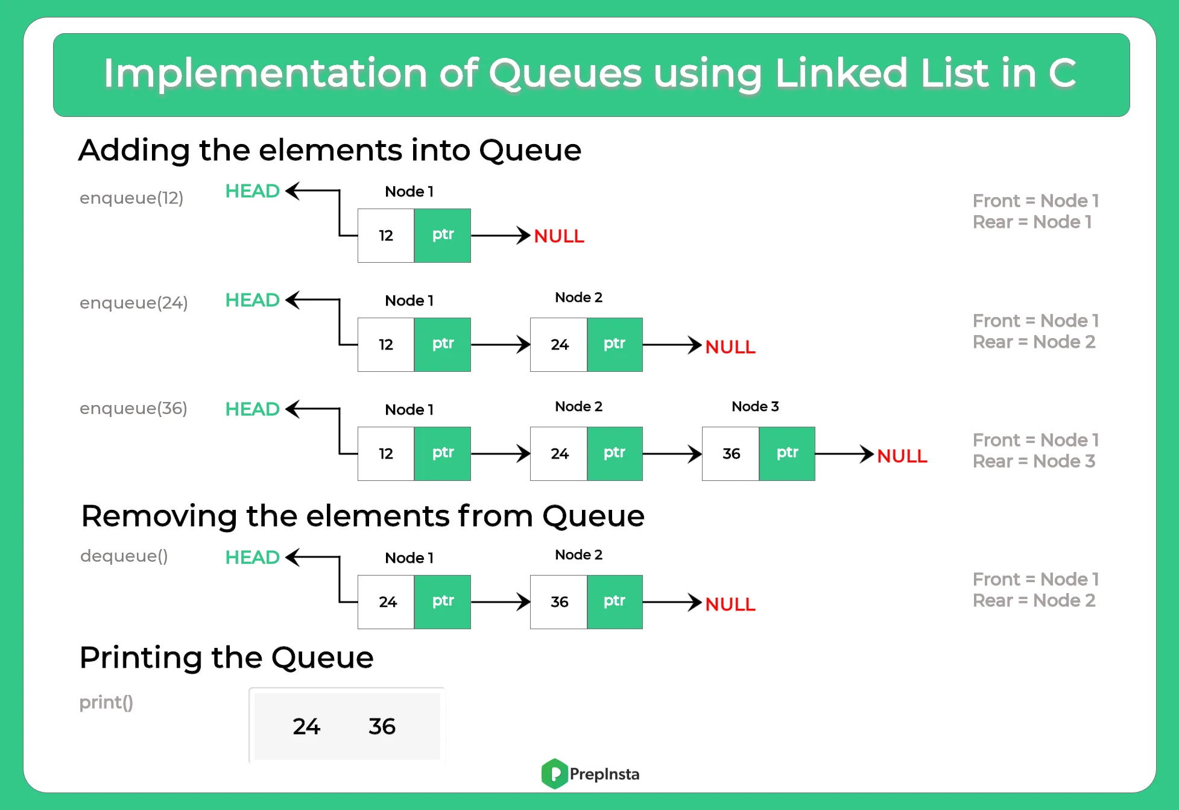

Slide 13
LinkQ_Insert(INFO,LINK,FRONT,REAR, AVAIL,ITEM)
This procedure inserts an ITEM into a linked queue
Step 1: [Available Space?]
if AVAIL =NULL,
then write “Overflow” and Exit
Step 2: [Remove first node from AVAIL list]
set NEW = AVAIL and AVAIL =LINK[AVAIL]
Step 3: set INFO[NEW] = ITEM and LINK[NEW] = NULL
[Copies ITEM into new node]
Step 4: if FRONT =NULL then FRONT = REAR = NEW
[If queue is empty then ITEM is the first element in the queue ]
else set LINK[REAR] = NEW and REAR = NEW
[REAR points to the new node appended to the end of the list ]
Step 5: Exit

Slide 14
LinkQ_Delete(INFO,LINK,FRONT,REAR, AVAIL,ITEM)
This procedure deletes the front element of the linked queue and stores it in ITEM
Step 1: [Linked queue empty?]
if FRONT =NULL,
then write “Underflow” and Exit
Step 2: set TEMP = FRONT [ if linked queue is nonempty, remember FRONT in temporary variable TEMP ]
Step 3: set ITEM = INFO[TEMP]
Step 4: set FRONT = LINK[TEMP]
[Reset FRONT to point to the next element in the queue]
Step 5: LINK[TEMP] = AVAIL and AVAIL =TEMP [return the deleted node TEMP to the AVAIL list]
Step 6: Exit

Slide 15

There are four different types of queues:
Linear Queue
Circular Queue
Priority Queue
Double Ended Queue
Linear Queue
In a simple queue, insertion takes place at the rear and removal occurs at the front. It strictly follows the FIFO (First in First out) rule.

Slide 16
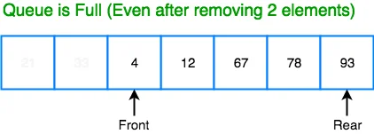
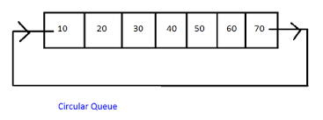
Circular Queue
In a circular queue, the last element points to the first element making a circular link.
The main advantage of a circular queue over a linear queue is better memory utilization. If the last position is full and the first position is empty, we can insert an element in the first position. This action is not possible in a linear queue.

Slide 17
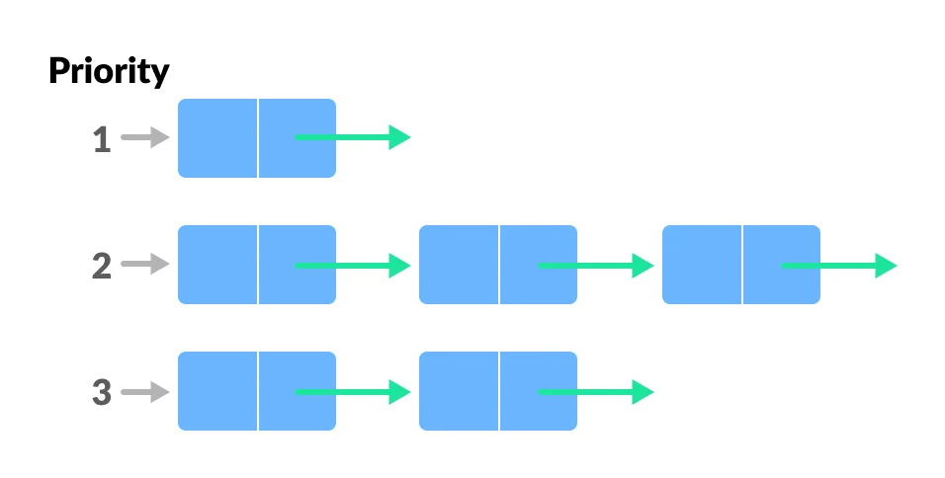
Priority Queue
A priority queue is a special type of queue in which each element is associated with a priority and is served according to its priority. If elements with the same priority occur, they are served according to their order in the queue.
Insertion occurs based on the arrival of the values and removal occurs based on priority.

Slide 18
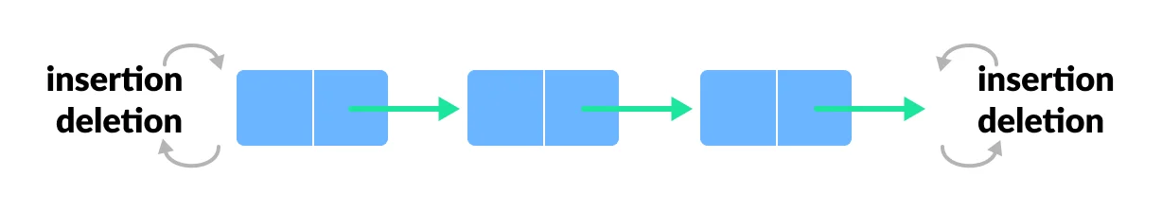
Deque (Double Ended Queue)
In a double ended queue, insertion and removal of elements can be performed either from the front or rear. Thus, it does not follow the FIFO (First In First Out) rule.
Types of Deque
Input Restricted Deque: In this deque, input is restricted at a single end but allows deletion at both the ends.
Output Restricted Deque: In this deque, output is restricted at a single end but allows insertion at both the ends.

Slide 19
Qinsert(Queue, Max, Front, Rear, Num)
This procedure inserts an element ITEM into a queue
Step 1: [Queue already filled?]
if Front = 0 and Rear = Max -1 OR Front = Rear + 1
then print “Overflow” and Exit
Step 2: if Front =-1 and Rear =-1 [Queue initially empty ]
set Front = Rear = 0
else if Rear =Max -1 and Front != 0
then set Rear = 0
else
Rear =Rear + 1
Step 3: set Queue[Rear] = Num [ This inserts new element]
Step 4: Exit

Slide 20
Qdelete(Queue, Max, Front, Rear, Num)
This procedure deletes an element from a queue and assigns it to the variable Num.
Step 1: [Queue already Empty?]
if Front = -1
then print “Underflow” and Exit
Step 2: set Num := Queue[Front]
Step 3: [find new value of Front]
if Front = Rear then [Queue has only one element ]
set Front = Rear = -1
else if Front = Max -1, then:
then set Front = 0
else
set Front = Front + 1
[End of If structure]
Step 4: Exit

Slide 21
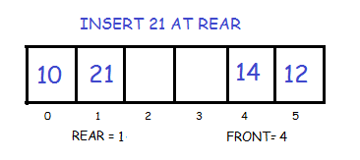
Insert Elements at Rear
Again we check if the queue is full. If its not full we insert an element at rear by following the given conditions:
If the queue is empty then initialize front and rear to 0. Both will point to the first element.
Else we increment rear and insert the element. Since we are using circular array, we have to keep in mind that if rear is equal to SIZE-1 then instead of increasing it by 1 we make it equal to 0.

Slide 22
Insert from Rear End in Dequeue
Step-1: [Check for overflow]
if(front == 0 and rear==Max-1 || front == rear + 1)
Print(“DeQueue is Overflow”);
return;
Step-2: [Insert Element]
if (front == -1)
front =rear=0;
else if (rear == Max -1 )
rear = 0
else
rear++;
dqueue[rear] = no
Step-3: return

Slide 23
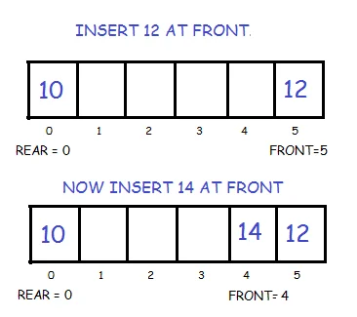
Insert Elements at Front
First we check if the queue is full. If its not full we insert an element at front end by following the given conditions :
If the queue is empty then initialize front and rear to 0. Both will point to the first element.
Else we decrement front and insert the element. Since we are using circular array, we have to keep in mind that if front is equal to 0 then instead of decreasing it by 1 we make it equal to SIZE-1.

Slide 24
Insert from Front End in Dequeue
Step-1: [Check for overflow]
if(front == 0 and rear==Max-1 || front == rear + 1)
Print(“DeQueue is Overflow”);
return;
Step-2: [Insert Element]
if (front == -1 && rear == -1)
front =rear=0;
else if (front=0)
front = Max -1
else
front = front - 1
dqueue[front] = no
Step-3: return

Slide 25
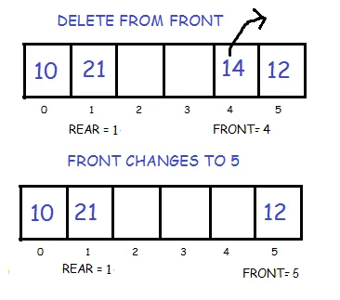
Delete Front Element
In order to do this, we first check if the queue is empty. If its not then delete the front element by following the given conditions :
If only one element is present we once again make front and rear equal to -1.
Else we increment front. But we have to keep in mind that if front is equal to SIZE-1 then instead of increasing it by 1 we make it equal to 0.

Slide 26
Delete element from Front End in Dequeue
Step-1: [Check for underflow]
if(front == -1)
Print(“DeQueue is Underflow”);
return;
Step-2: num = dqueue[front]
Step-3: if (front == rear)
front =rear= -1;
else if (front=Max -1)
front = 0;
else
front = front + 1
Step-3: return

Slide 27
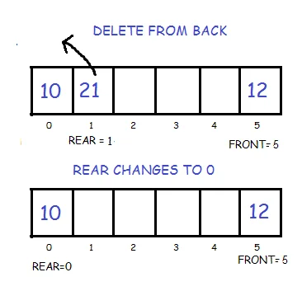
Delete last element (delete from rear end)
To do this, we again first check if the queue is empty. If its not then we delete the last element by following the given conditions :
If only one element is present we make front and rear equal to -1.
Else we decrement rear. But we have to keep in mind that if rear is equal to 0 then instead of decreasing it by 1 we make it equal to SIZE-1.

Slide 28
Delete element from Rear End in Dequeue
Step-1: [Check for underflow]
if(front == -1)
Print(“DeQueue is Underflow”);
return;
Step-2: num = dqueue[rear]
Step-3: if (front == rear)
front =rear= -1;
else if (rear == 0)
rear = Max - 1;
else
rear = rear - 1
Step-4: return

Slide 29
Applications Of Stack
Evaluation of Arithmetic Expressions
for expression conversion
Backtracking
Stacks and Recursion

Slide 30
Evaluation of Arithmetic Expressions
A stack is a very effective data structure for evaluating arithmetic expressions in programming languages. An arithmetic expression consists of operands and operators.
A + (B - C)
To evaluate the expressions, one needs to be aware of the standard precedence rules for arithmetic expression. The precedence rules for the five basic arithmetic operators are:
Operators | Precedence
^ exponentiation | Highest followed by *Multiplication and /division
*Multiplication, /division | Highest followed by + addition and - subtraction
+ addition, - subtraction | lowest

Slide 31
Infix Notation | Prefix Notation | Postfix Notation
A * B | * A B | AB*
(A+B)/C | /+ ABC | AB+C/
(A*B) + (D-C) | +*AB - DC | AB*DC-+

Slide 32
Evaluation of a postfix Expression
Algorithm: This algorithm finds the VALUE of an arithmetic expression P written in postfix notation.
1. Add a right parenthesis “)” at the end of P. [This acts as a sentinel.]
2. Scan P from left to right and repeat Steps 3 and 4 for each element of P until the sentinel “)” is encountered.
3. If an operand is encountered , put it on STACK
4. If an operator is encountered, then:
(a) Remove the top two elements of STACK, where A is top element and B is the next- to-top element.
(b) Evaluate B A
(c) Place the result of (b) back on stack.
[End of If structure]
[End of step 2 loop ]
5. Set VALUE equal to the top element on STACK.
6. Exit.

Slide 33
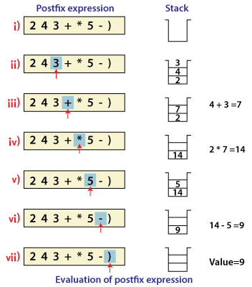

Slide 34
Postfix Expression | STACK | Operation
4 5 6 * + ) | empty
4 | 4
5 | 4 5
6 | 4 5 6
* | 4 30 | 5 * 6 = 30
+ | 34 | 4 + 30 =34
)
Ex: 3 4 * 2 5 * +

Slide 35
Postfix Expression | STACK | Operation
5 6 2 + * 12 4 / - ) | empty
5 | 5
6 | 5 6
2 | 5 6 2
+ | 5 8 | 6 + 2 = 8
* | 40 | 5 * 8 =40
12 | 40 12
4 | 40 12 4
/ | 40 3 | 12 / 4 = 3
- | 37 | 40 – 3 =37
) | 37

Slide 36
Postfix Expression | STACK | Operation
3 4 * 2 5 * + | Empty
3 | 3
4 | 3 4
* | 12 | 3 * 4 =12
2 | 12 2
5 | 12 2 5
* | 12 10 | 2 * 5= 10
+ | 22 | 12 +10=22
)

Slide 37
Prefix Expression | STACK | Operation
+9*26 | empty
6 | 6
2 | 6 2
* | 12 | 2 * 6 =12
9 | 12 9
+ | 21 | 9 + 12 =21
) | 21
* + 6 9 - 3 1

Slide 38
Prefix Expression | STACK | Operation
- / * 20 * 50 + 3 6 300 2 | empty
2 | 2
300 | 2 300
6 | 2 300 6
3 | 2 300 6 3
+ | 2 300 9 | 3 + 6 =9
50 | 2 300 9 50
* | 2 300 450 | 50 * 9 = 450
20 | 2 300 450 20
* | 2 300 9000 | 20 * 450= 9000
/ | 2 30 | 9000 / 300 = 30
- | 28 | 30 – 2 =28
) | 28

Slide 39
Conversion of Infix expression into Postfix Expression
Algorithm: Polish(Q,P)
Suppose Q is an arithmetic expression written in infix notation. This algorithm finds the equivalent postfix expression P.
1. Push “(“ onto the STACK, and add “)” to the end of Q.
2. Scan Q from left to right and repeat Steps 3 to 6 for each element of Q until the STACK is empty:
3. If an operand is encountered ,add it to P.
4. If a left parenthesis is encountered, push it onto STACK.
5. If an operator is encountered, then:
(a) Repeatedly pop from STACK and add to P each operator (on the top of STACK) which has the same precedence as or higher precedence than .
(b) add to STACK.
[End of If structure]
6. If a right parenthesis is encountered, then:
(a) Repeatedly pop from STACK and add to P each operator ( on the top of stack ) until a left parenthesis is encountered.
(b) Remove the left parenthesis.[Do not add the left parenthesis to P.]
[End of If structure]
[End of step 2 loop ]
7. Exit.

Slide 40
Symbol Scanned | STACK | Expression
A | ( | A
+ | ( + | A
( | ( + ( | A
B | ( + ( | A B
* | ( + ( * | A B
C | ( + ( * | A B C
- | ( + ( - | A B C *
( | ( + ( - ( | A B C *
D | ( + ( - ( | A B C * D
/ | ( + ( - ( / | A B C * D
E | ( + ( - ( / | A B C * D E
^ | ( + ( - ( / ^ | A B C * D E
F | ( + ( - ( / ^ | A B C * D E F
) | ( + ( - ( / | A B C * D E F ^
* | ( + ( - * | A B C * D E F ^ /
G | ( + ( - * | A B C * D E F ^ / G
) | ( + | A B C * D E F ^ / G * -
* | ( + * | A B C * D E F ^ / G * -
H | ( + * | A B C * D E F ^ / G * - H
) |  | A B C * D E F ^ / G* - H * +

Slide 41
Symbol Scanned A^B/(C*D)+E | STACK | Expression
A | ( | A
^ | ( ^ | A
B | ( ^ | A B
/ | ( / | A B^
( | ( / ( | A B ^
C | ( / ( | A B ^C
* | ( / ( * | A B ^C
D | ( / ( * | A B^ C D
) | ( / | A B ^C D *
+ | ( + | A B ^C D * /
E | ( + | A B^ C D * / E
) |  | A B^ C D * / E +

Slide 42
Symbol Scanned | STACK | Expression
Q | ( | Q
+ | ( + | Q
T | ( + | Q T
* | ( + * | Q T
V | ( + * | Q T V
/ | ( + * / | Q T V
U | ( + * / | Q T V U
/ | ( + * / / | Q T V U
W | ( + * / / | Q T V U W
* | ( + * / / * | Q T V U W
( | ( + * / / * ( | Q T V U W
P | ( + * / / * ( | Q T V U W P
^ | ( + * / / * ( ^ | Q T V U W P
O | ( + * / / * ( ^ | Q T V U W P O
) | ( + * / / * | Q T V U W P O ^
+ | (+ + | Q T V U W P O ^ * / / *
N | (+ + | Q T V U W P O ^ * / / * N
* | (+ + * | Q T V U W P O ^ * / / * N
M | (+ + * | Q T V U W P O ^ * / / * N M
- | (+ + - | Q T V U W P O ^ * / / * N M *
L | ( + + - | Q T V U W P O ^ * / / * N M*L
+ | (+ + - + | Q T V U W P O ^ * / / * N M*L
K | (+ + - + | Q T V U W P O ^ * / / * N M*L K + - + +

